Slide 1
3D Printing
WherE DiD It Start?
What can it be used for?
How DOES it work?
How much, whats available?
Where is it going?

Slide 2
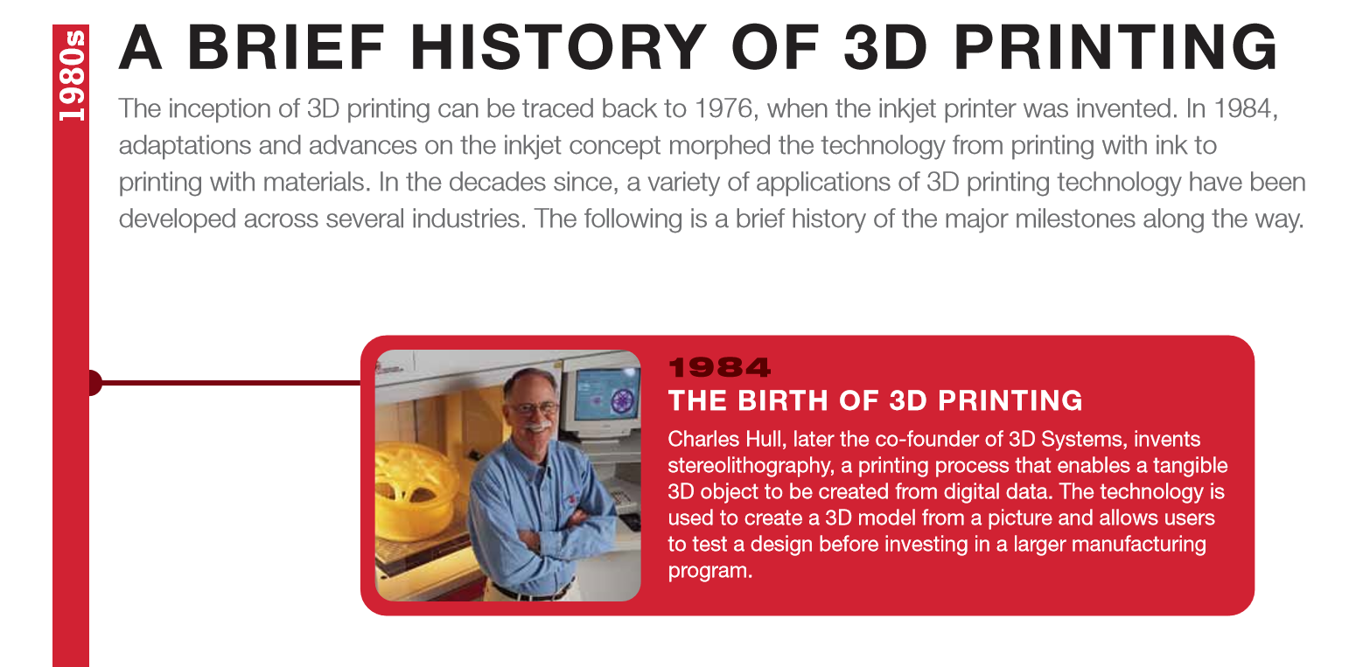
WherE DiD It Start?

Slide 3
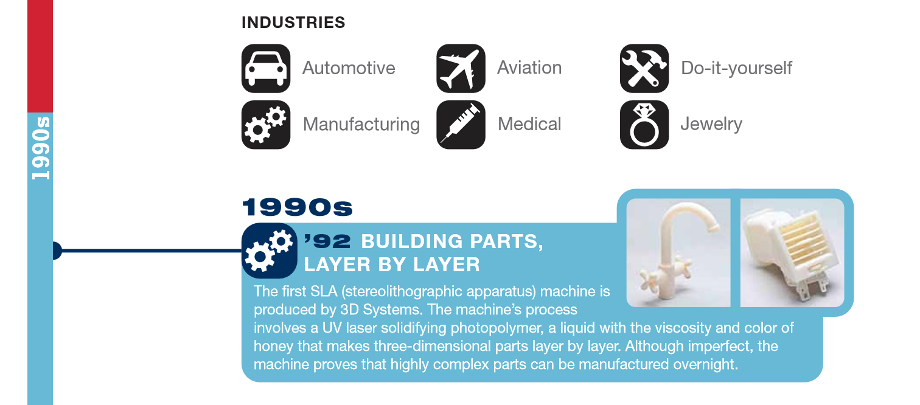
What can it be used for?

Slide 4
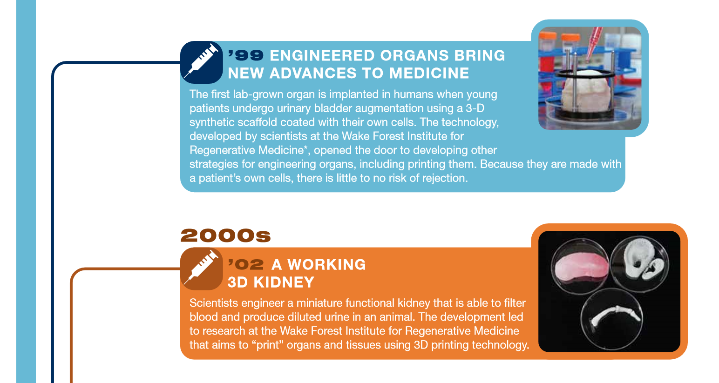

Slide 5
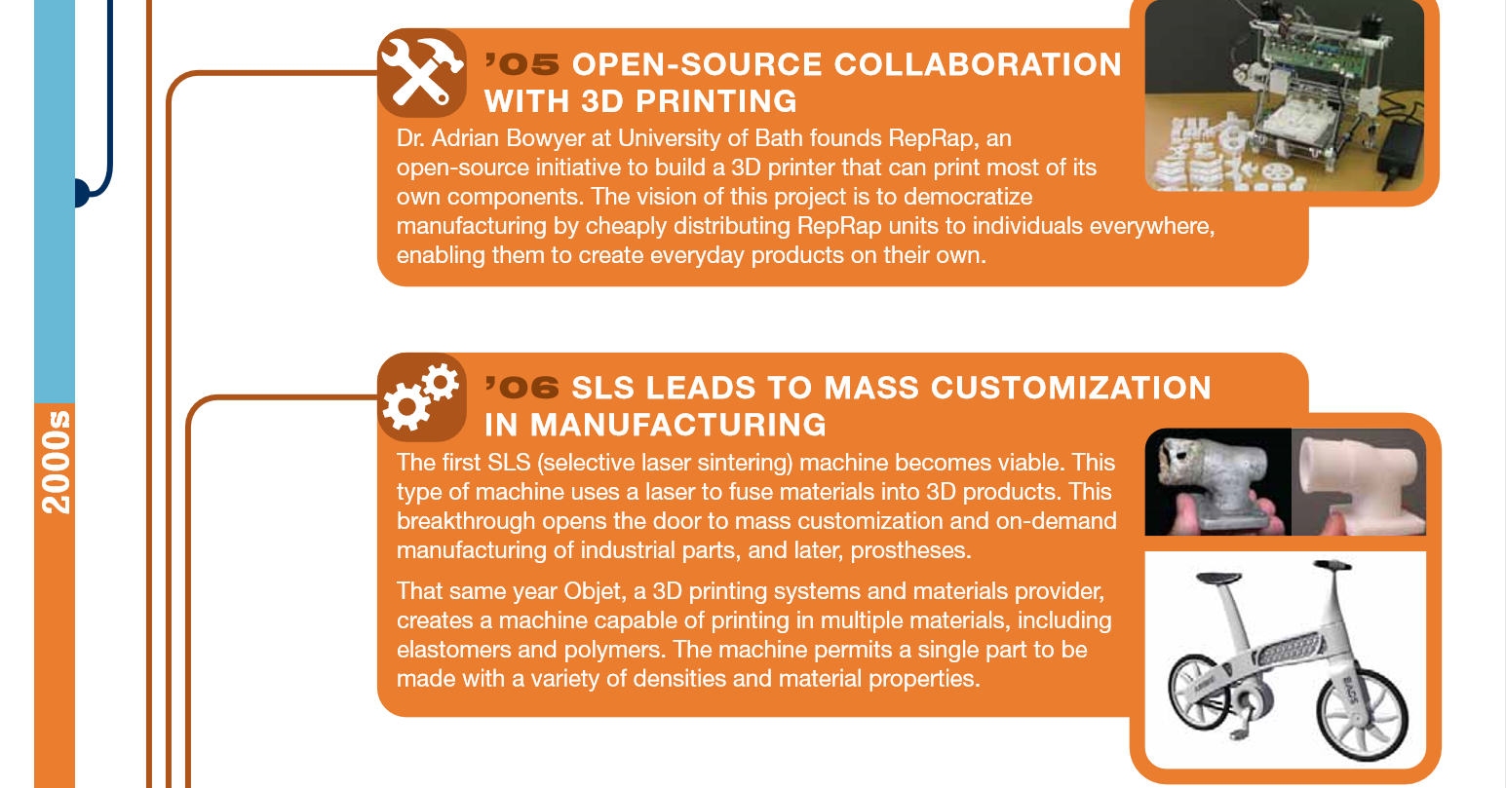

Slide 6
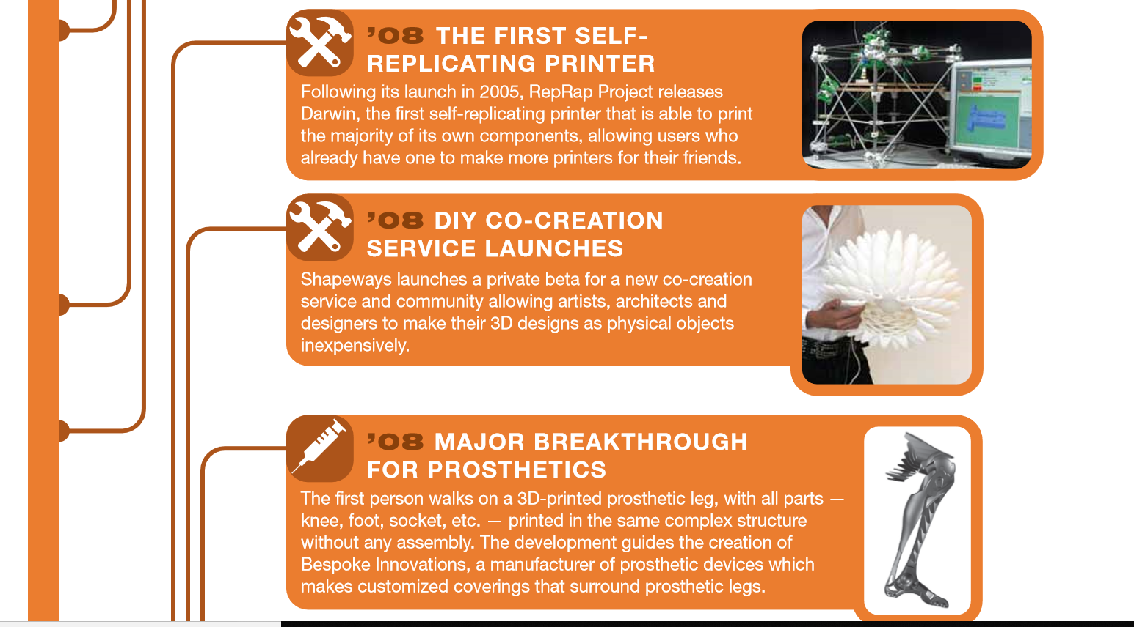

Slide 7
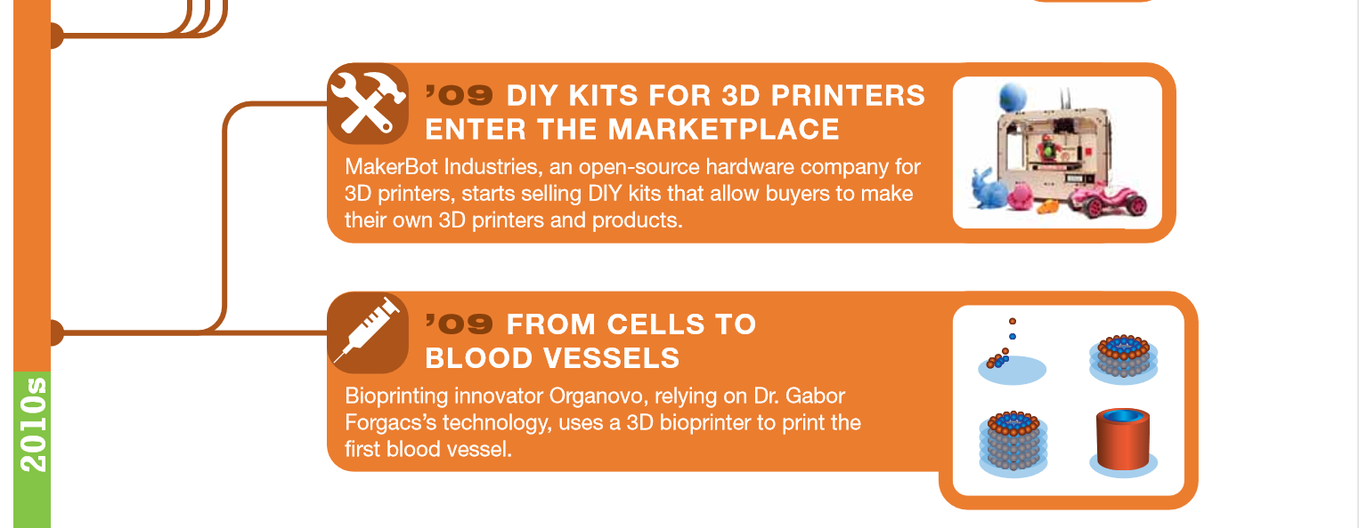

Slide 8
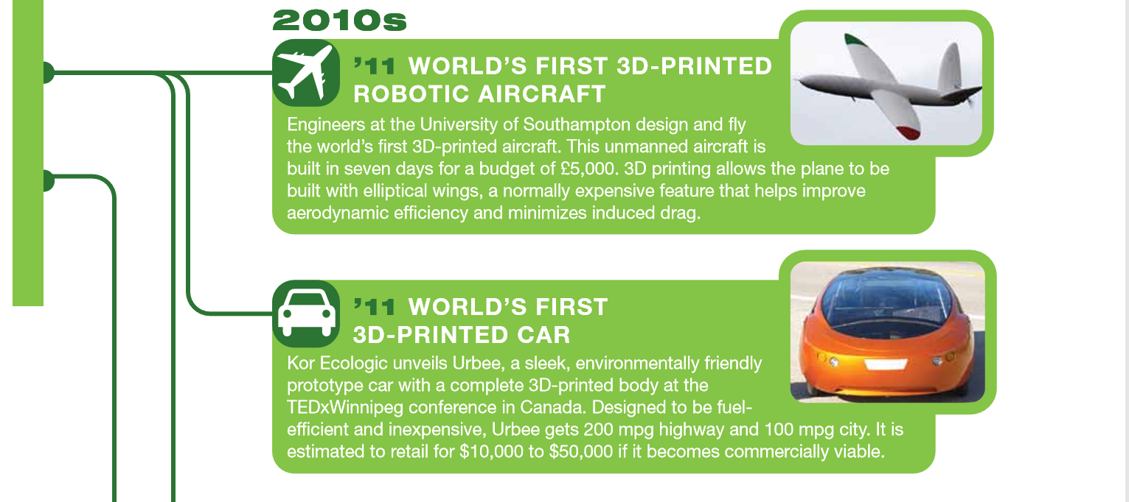
What can it be used for?

Slide 9
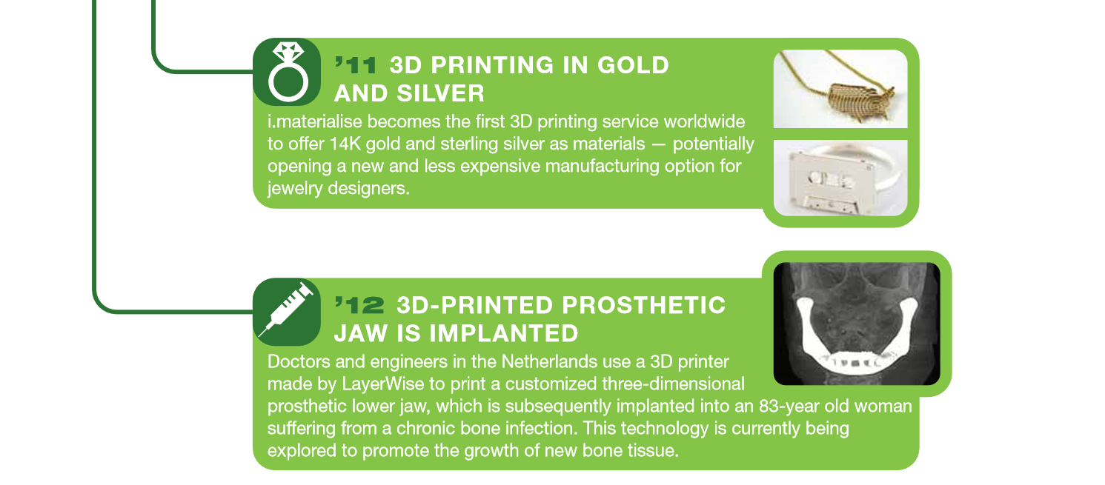

Slide 10
How DOES it work?
3D Printing Terminology
RepRap: RepRap is shorthand for “replicating rapid prototypers”, machines which are open-source 3D printers utilizing the Fused Filament Fabrication process. One of the defining characteristics of a RepRap machine is that it should be capable of printing out its own parts (but not necessarily all of them). Various RepRap designs and build instructions are freely downloadable from reprap.org, where they proudly describe their printers as “humanity’s first general-purpose self-replicating manufacturing machines”.
Additive Manufacturing: A process of building up a 3 dimensional object one thin layer at a time. 3D printing is only one category of Additive Manufacturing, however it is mostly applied to 3D printing today.

Slide 11
Filament: is the base material that’s used to 3D print objects via fused deposition modeling (FDM). Filament is usually a thermoplastic — such as ABS or PLA — that’s fed to a computer controlled print head as a solid, then heated to melting point for extrusion through a small nozzle. The nozzle deposits one layer at a time onto the print bed. Filament is commonly available in spools of either 1.75mm and 3 mm diameters. Many colors are available including ‘Wood’. Samples of colors and ‘Wood’ are next to the machine on the table.
Fused Deposition Modeling (FDM): Uses Filament process described above. FDM is actually a term that’s been trademarked by Stratasys. This led to the RepRap open-source community to coin the term “fused filament fabrication” (FFF) for a more generalized and legal way to describe the process.
Fused Filament Fabrication (FFF): Alternate name for FDM described in previous bullet.

Slide 12
ABS: Acrylonitrile Butadiene Styrene filament. The ABS filament is heated and squirted (extruded) onto the printing bed in very fine layers.
Polylactic Acid (PLA): Polylactic Acid, otherwise known as PLA, is a biodegradable plastic that’s used as the build material or ‘filament’ in fused deposition modeling 3D printers. This material is easier to work with than ABS, and the smell is not so unpleasant, but the trade-off is that PLA is structurally more brittle.
DMLS or SLS - Direct Metal Laser Sintering or Selective Laser Sintering: is a technology commonly employed by 3D printing services for metallic objects. SLS is a powder bed fusion 3D printing technique that uses a laser to selectively fuse — or sinter — together the granules of successive layers of powder.
Stereolithographic Apparatus (SLA): is a 3D printing technology that works via a process called vat photopolymerization. Objects are built in layers. This works using a laser beam to trace out and solidify each successive layer of an object on the surface (or base) of a vat of liquid photopolymer.

Slide 13
Where did the simple low cost commercially available machine start:
In 2009 Joseph Prusa in the Czech Republic, using the 2005 RepRap concept, developed a set of standards for an open sourced 3D PLA/ABS Extrusion machine using an Arduino 2650 single board computer and a CNC driver board, stepper motors and hardware. The original 2005 RepRap design and implementation was carried out by 2 Universities in the UK. Metric kits of the PRUSA and PRUSA Mendel machines were sold all over the world. Kits arriving in the US were all Metric. It was 2012 before US ‘inch’ machines were available.
In 2012 a friend of mine, at Raytheon, bought a Prusa Mk1 RepRap kit for $610. See next slide photo of this, then, advanced design.
Back then software was a bit clumsy and relied on very early Rendering and Slicing Software. Autocad was a major player in the 3D software business followed by many imitators. Such programs as Blender and Autodesk were available for free download. The processor software was adapted from early CNC milling machines. Today there are dozens of 3D software, rendering and slicing software packages, many free, open source programs.

Slide 14
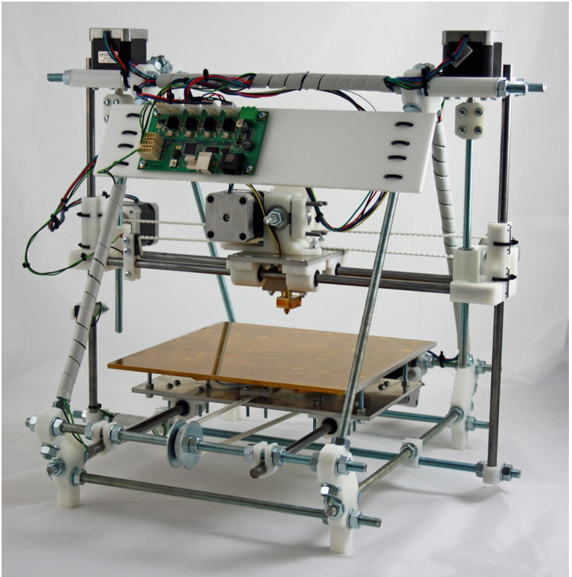
Early Prusa Open
Source 3D Printer,
Circa 2012

Slide 15
How much, what's available?
Today Amazon lists over 50 machines from $159 to $5,000, plus Filament materials and parts. eBay currently has over 10,000 listings for machines parts and Filament. As usual with eBay, there are many entries with the same machine but different prices and different shipping options. Because of the open license for the Prusa machine design many manufacturers have sprung up in China, Taiwan and other Asian countries where production lines of printers are hard at work producing your next bath brush, frypan Spatula or Kenwood/Icom Knob.
The machine on the table is a kit from GEEETECH in Shenzen, costs $189 with the WiFi module and is shipped from Amazon distribution centers. It is based on the PRUSA i3. The Geeetech model is; i3 Pro W. If you look closely the frame is made of laminated Wood. The same hardware is available with an acrylic or aluminum frame.
I built this kit with a non-technical friend, it took around 40 hours. Assembly of the kit met several problems, one of which was the Chinglish assembly and Users manuals. Others were sequence of assembly, fit of parts. I solved several problems for the supplier, and am currently rewriting the assembly manual, in MS Word, Track Changes On!

Slide 16
Because the kit came from US stock, Amazon Distribution Center, a major change had not been included in the kit. The ‘Z’ axis used 8mm Threaded rods. The rods were bent and caused various components to jog around and bind. I read all the Blogs and ordered some 8mm Lead Screw rods to try them. Contact with the supplier revealed that they had changed the design and now used 8mm dia, 8mm lead, 4 start Lead Screw rods. The supplier sent me a mod kit via DHL priority, with an apology. It worked great and even better when I added spring tensioners to the Lead Screws.
The whole point of this bullet is that, any Kit machine, or ready built machine you buy, check with the manufacturer to make sure you have the latest kit parts, firmware and software.
There are dozens of variations of this ReRap/Prusa open source architecture, but the key is that the Stepper motors are similar, the extruder heads are similar, the screw thread rods, slide rods and Lead screw rods are similar and, are available as parts for spares, or building a machine. The GEEETECH and others use the All-in-one, GT2650 Processor and driver board. A photo of the board is shown below.

Slide 17
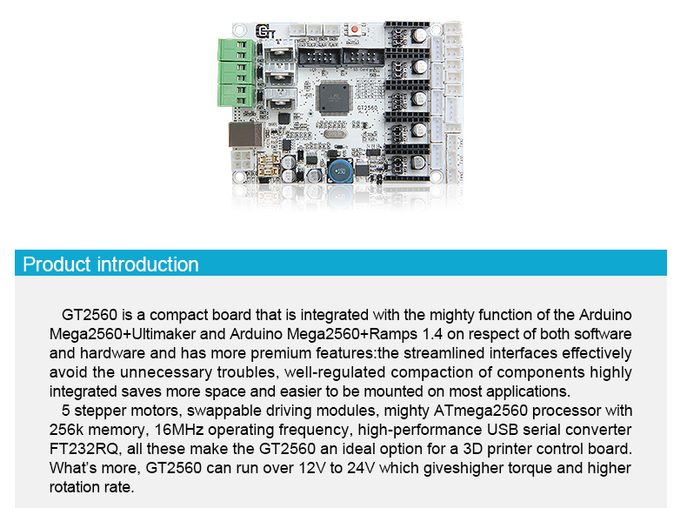

Slide 18
Where is it going?
Office block complete with decoration and furniture built in 17 days
Livable house built in 16 hours
Chinese companies have thousands of 3D printers producing your next bath brush/comb/spatula/pen/mouse.
15 Cooper S Minis with major 3D printed parts sold in France
Boeing/Lockheed plan to place 3D printing facilities around the world to print metal and plastic component spares
2019 BMW has 3D printed components
Several new ‘supercars’ built with 3D printing
3D printer on ISS (3rd generation) is not there for fun. NASA are experimenting with machines to make tools and components and spare parts on interstellar flights.
Bones and body parts being built with 3D printing, all over the world.
YEGGI Web site as of 1/14/19, has 1.72M 3D printer files. (https://www.yeggi.com/)
Thingiverse Web site as of 1/14/19, has 1.278M 3D printer files (https://www.thingiverse.com/explore/newest/3d-printing/)
The following slides illustrate what is happening in the ‘Additive Manufacturing’, ‘3D printing’ world around us.

Slide 19
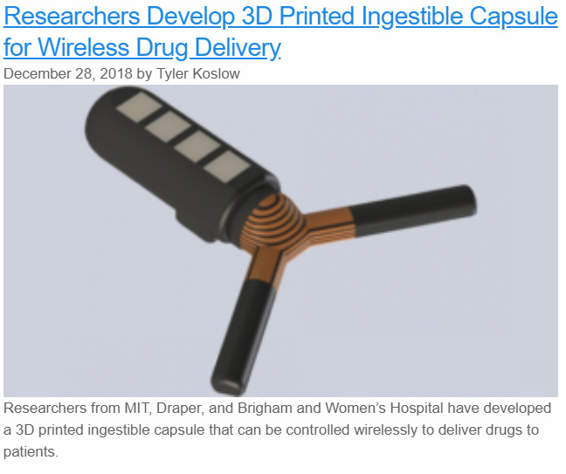
Where is it going?

Slide 20
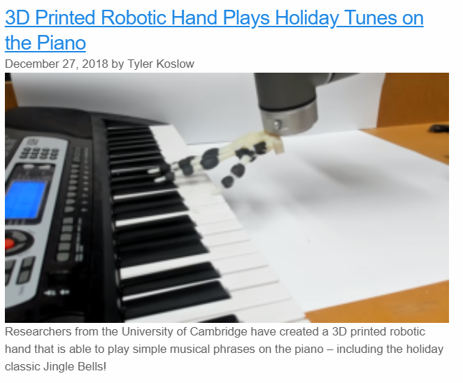
Where is it going?

Slide 21
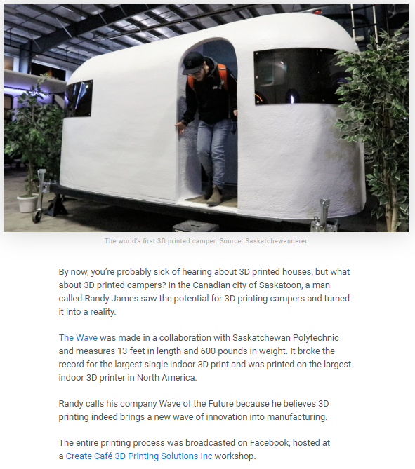

Slide 22
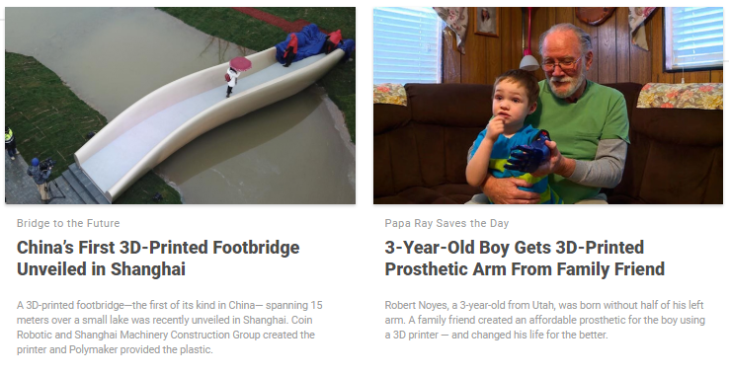

Slide 23
What Now!
3D printing, Additive Manufacturing, is expanding in leaps and bounds, from outdoor printing of buildings, to indoor printing of campers, to body parts, to metal components.
Buying a $200 printer and a couple of $23 rolls of Filament could get you on your way to experimenting, making useful things from web based .stl files.
Near future scenario:
Nuts & Volts Magazine or Elektor, or QST or QSX, project for a 40W Self Modulated Hoopty Do**. Go to Website www.Hoopty.Do and download the:
- Schematic
- Parts List
- PC Board pattern
- Alignment Instructions
3D printing .STL file for the Cabinet & Front Panel
** Hoopty Do, a mythical electronic device that does not do much of anything.

Slide 24
Big Story:
Chef BoyRaudee decides he needs new utensils, 3D prints own fry pan, spatula, saucepan, knives, forks, spoons, plates and Meat Balls, for the 2019 CMARA Holiday Party.

Slide 25
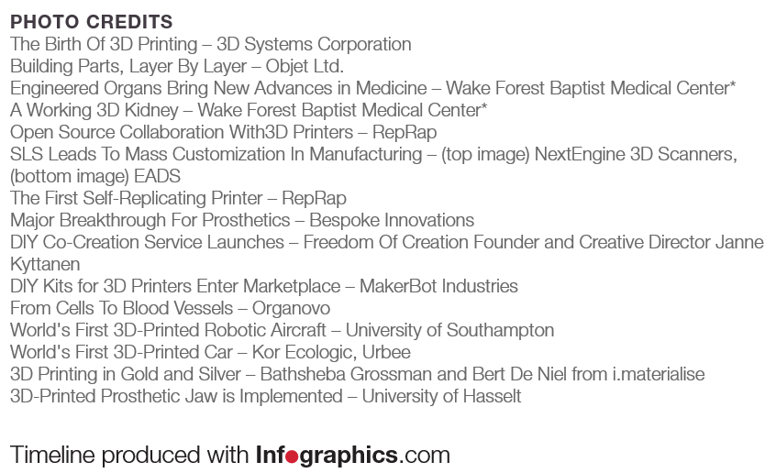
The Credits
Camper, Bridge and other photos & statements from, All3DP Web Magazine. (https://all3dp.com/3d-printing-news/)
Chef BoyRaudee, thanks for your sense of humor. Glad we did not ask your permission!

